Slide 1
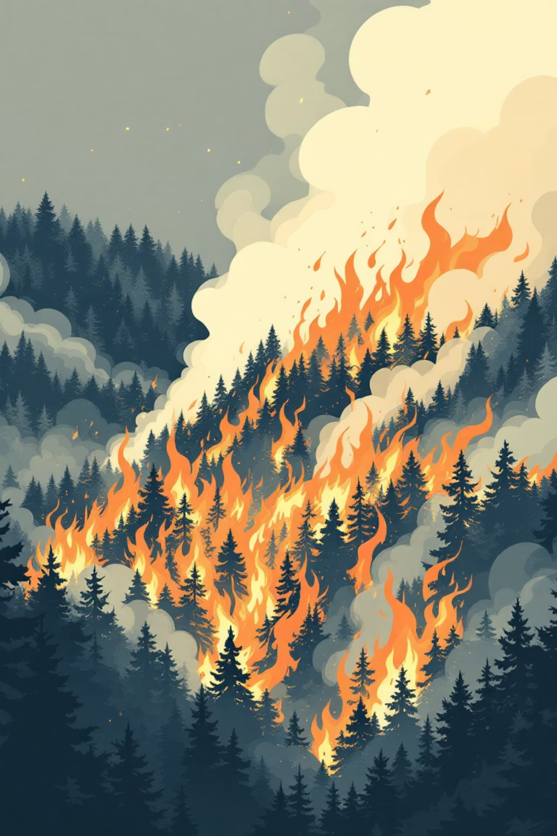
Combating Wildfires: A High-Tech Approach
Wildfires pose an increasing threat to lives, property, and natural ecosystems. This presentation outlines a cutting-edge solution leveraging AI and advanced monitoring to detect and mitigate these devastating events.

Slide 2
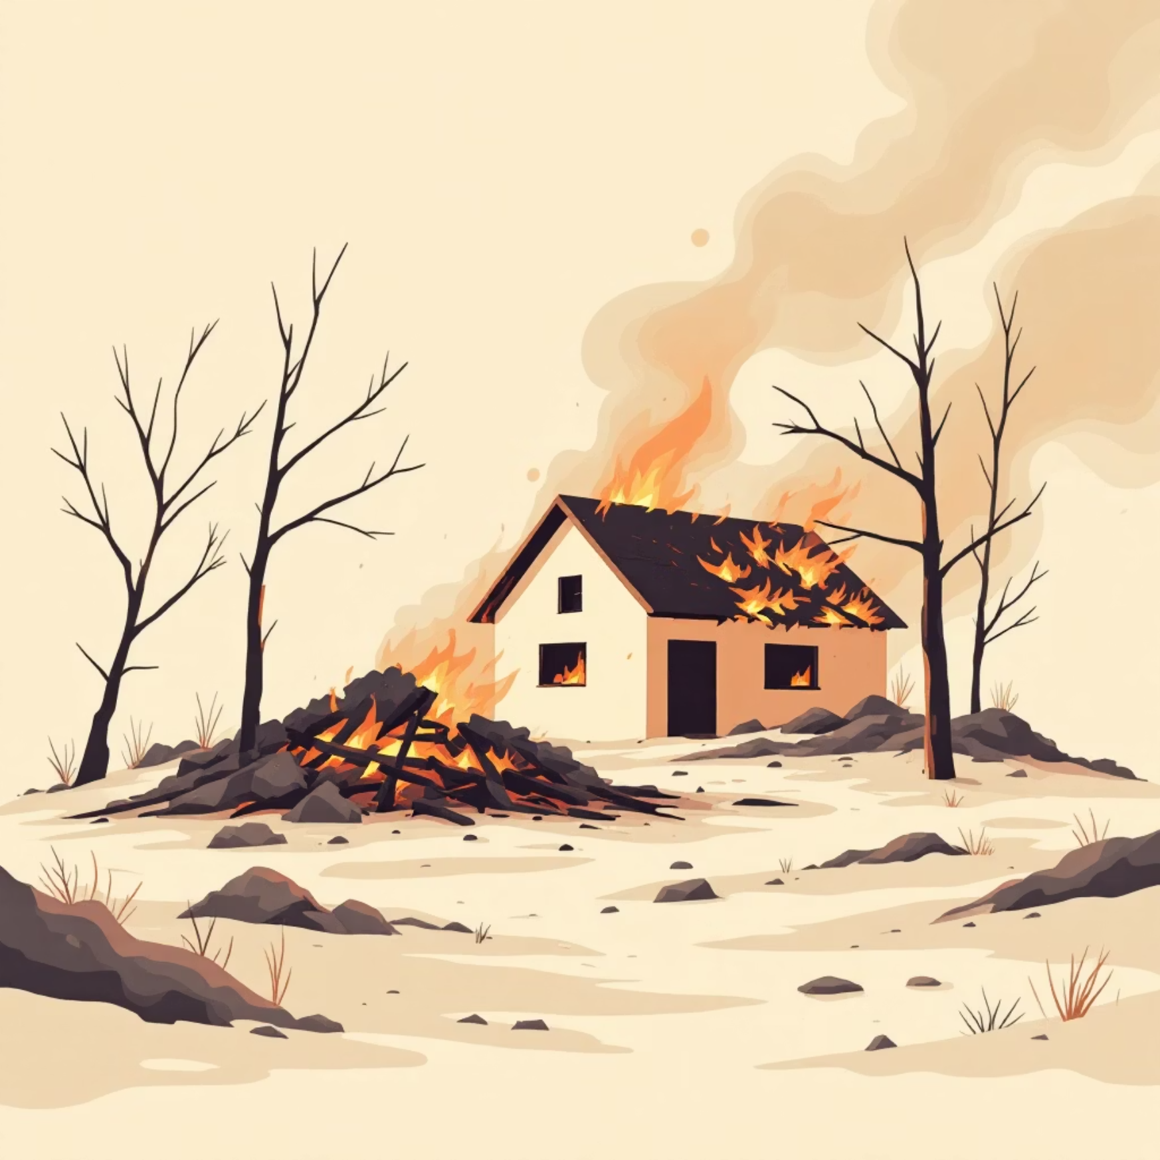
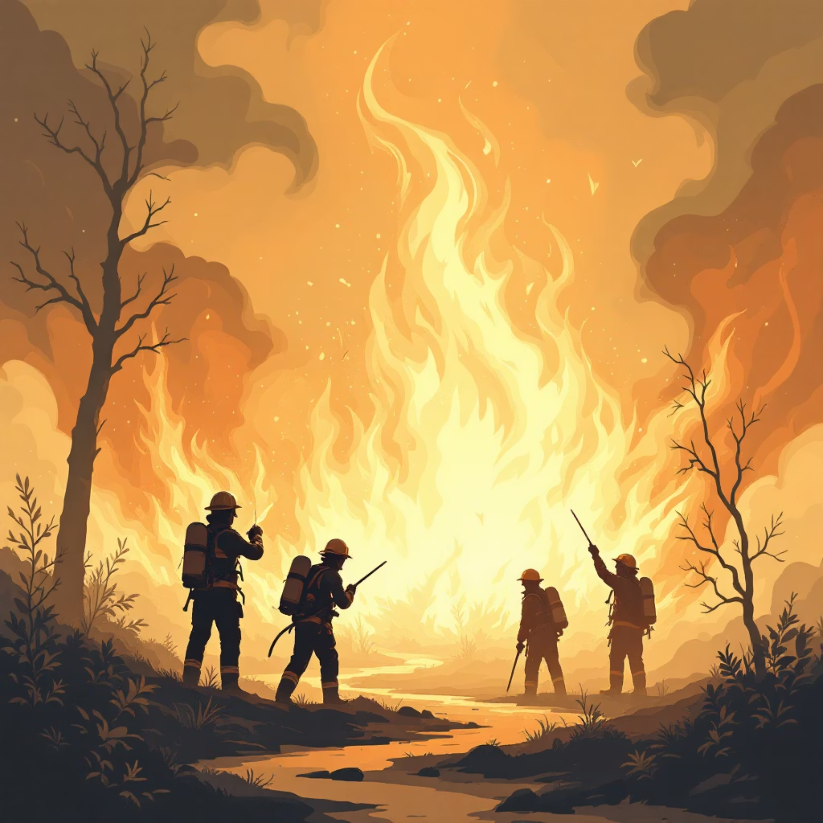
The Escalating Wildfire Crisis
Wildfires are growing in frequency and intensity, driven by climate change, prolonged droughts, and human activity. The consequences are dire, leading to billions in damages, displacement, and tragic loss of life.
Each year, these infernos destroy thousands of homes, devastate vital infrastructure, and release massive amounts of carbon into the atmosphere, exacerbating climate issues.
Emergency responders face immense challenges in containment, often battling unpredictable fire behavior and limited visibility. Early detection is paramount for effective intervention.

Slide 3

Impact and Scope of Wildfire Devastation
The economic and environmental costs of wildfires are staggering. Beyond immediate destruction, long-term impacts include ecosystem degradation, air quality issues, and health risks.
$20B
10M
1.5K
Annual Damages
Acres Burned
Lives Lost
Estimated cost of wildfire suppression and property loss in the US.
Average acreage consumed by wildfires annually in the US over the last decade.
Tragic number of fatalities linked to wildfires in the past five years.

Slide 4

The Need for Rapid Detection
Current detection methods often rely on human observation, which can be slow and susceptible to error. The critical window for containment is often lost before a fire is even reported.
Manual Spotting
Delayed Response
Resource Strain
Human patrols and lookout towers are limited by visibility and coverage area.
Every minute counts. Late detection allows fires to grow exponentially, making them harder to control.
Larger, uncontrolled fires demand more resources, stretching emergency services thin.

Slide 5
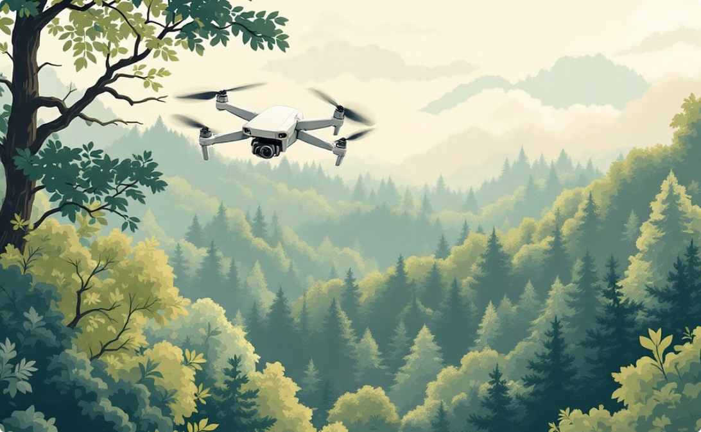
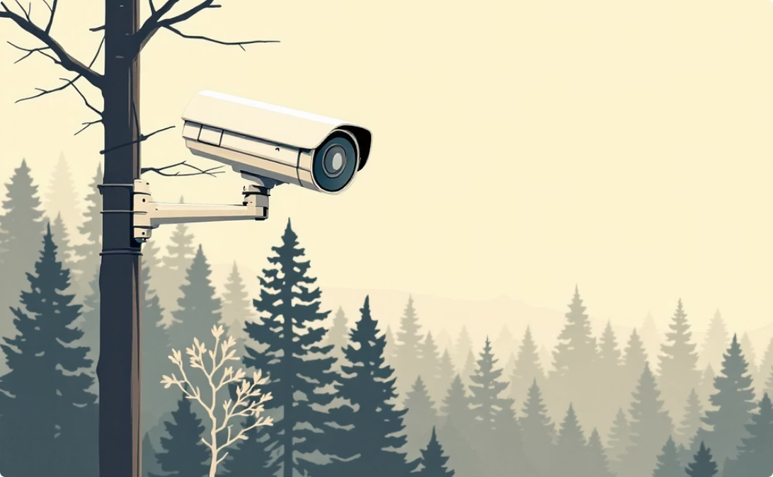

Introducing AlexNet for Wildfire Surveillance
Our solution employs AlexNet, a state-of-the-art Convolutional Neural Network (CNN), integrated with a network of drones, cameras, and satellites for real-time wildfire detection.
Drone Surveillance
Ground Cameras
Satellite Imagery
Agile drones provide close-up, high-resolution imagery and thermal data from potential fire zones.
Static cameras deployed in high-risk areas offer continuous monitoring and initial smoke detection.
Satellites provide broad, comprehensive coverage, identifying hot spots and large-scale smoke plumes.

Slide 6

AlexNet Architecture: The Core of Detection
AlexNet is a powerful CNN designed for image recognition. Its multi-layered structure allows it to learn complex features, making it ideal for distinguishing fire and smoke from benign forest imagery.
Input Layer
Conv + ReLU
Max Pooling
Fully Connected
This deep learning architecture processes visual data to identify the subtle signatures of incipient wildfires.

Slide 7
Layer by Layer: How AlexNet Learns
1
2
3
Convolutional Layers
ReLU Activation
Max Pooling Layers
Extract features like edges, textures, and patterns. Multiple layers build increasingly complex representations.
Introduces non-linearity, allowing the network to learn more complex relationships in the data.
Reduces dimensionality, making the model more robust to variations in image position and scaling.
4
5
Fully Connected Layers
Output Layer (Softmax)
These layers interpret the high-level features and make the final classification decision.
Generates probabilities for each class (e.g., 'fire,' 'smoke,' 'no fire'), indicating detection confidence.

Slide 8
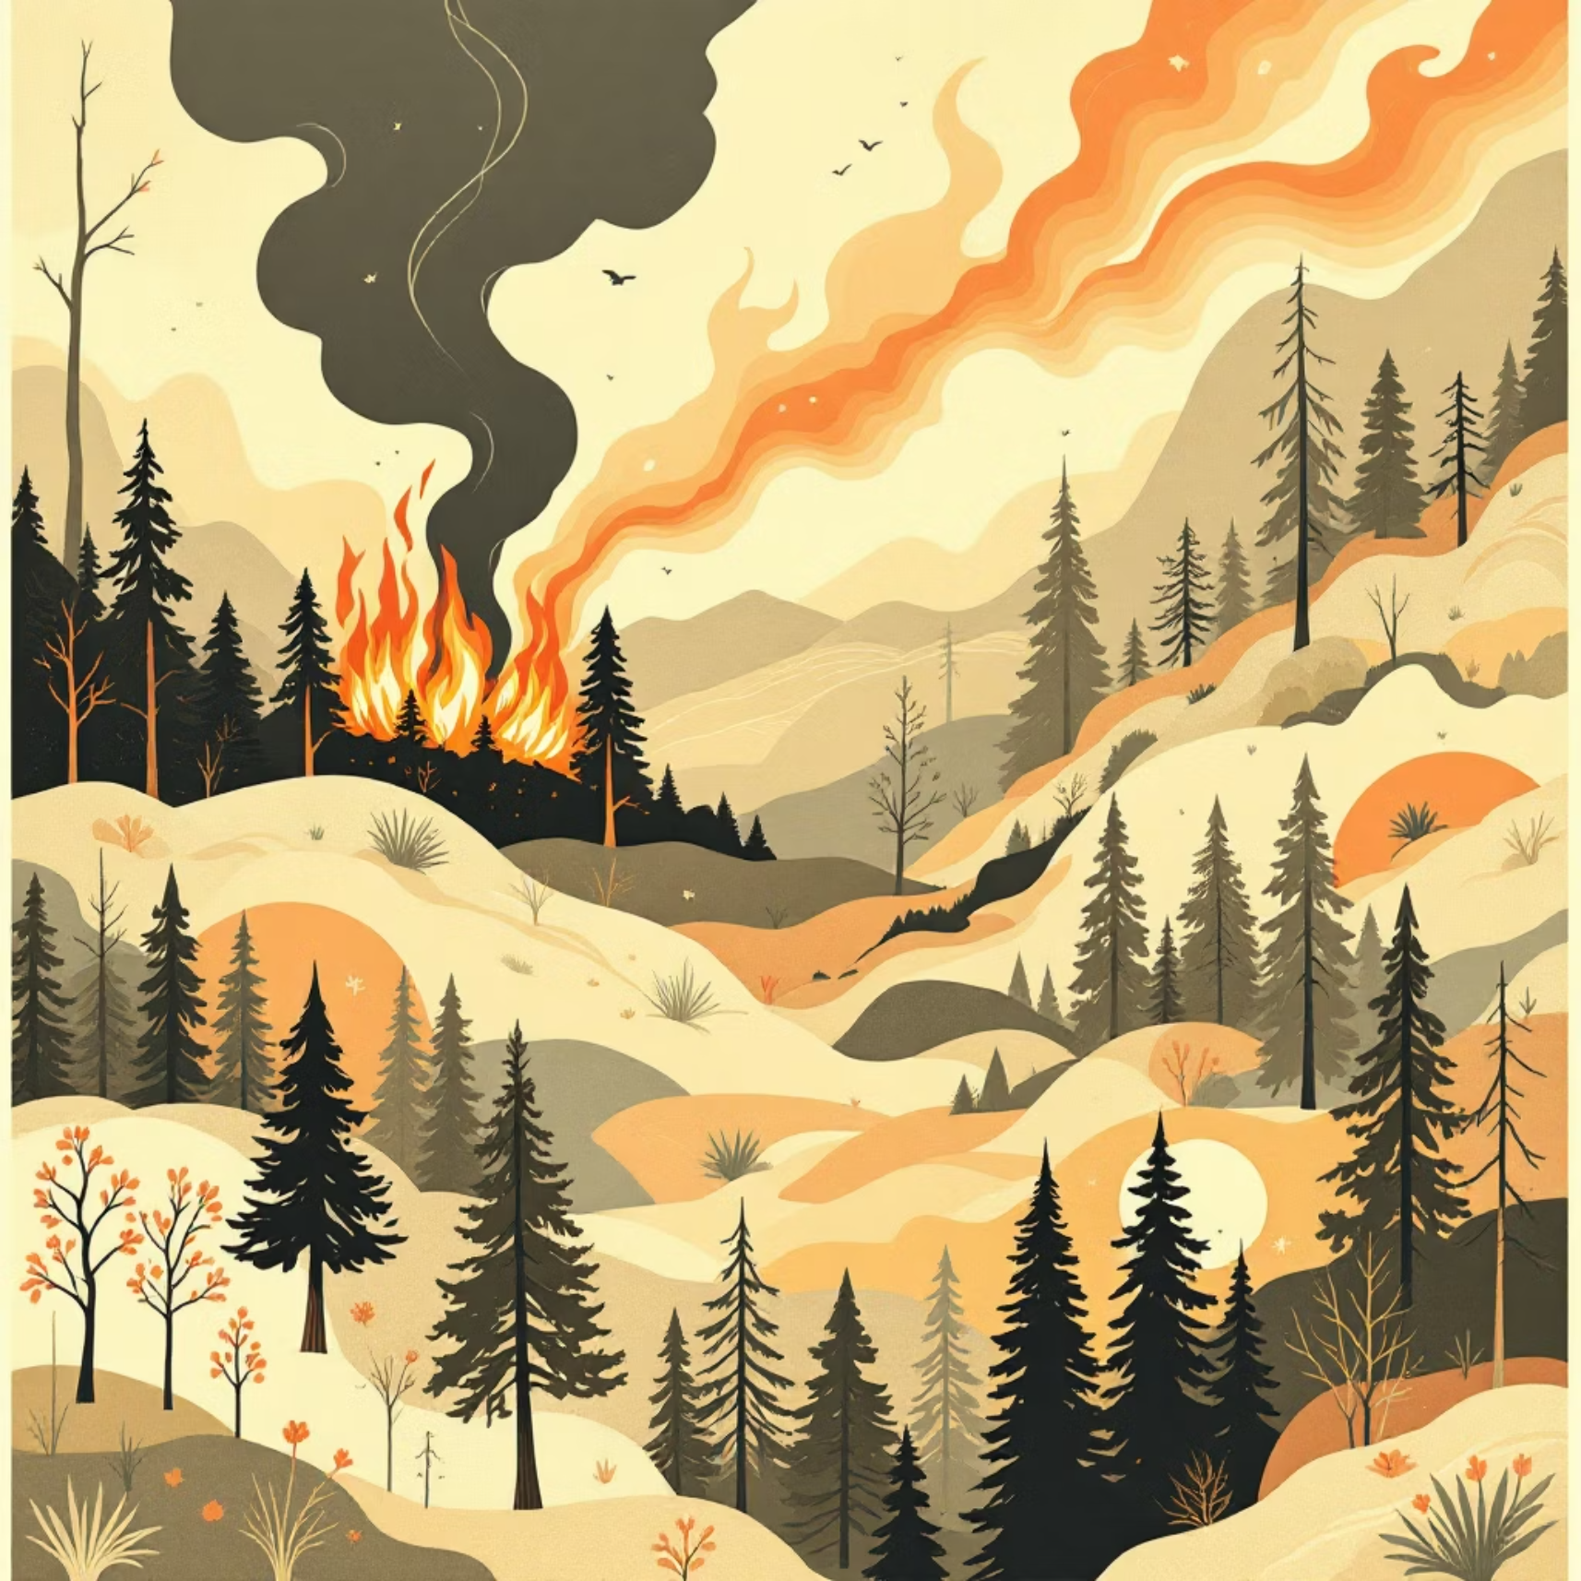
The Training Process: Fueling the AI
AlexNet's effectiveness hinges on rigorous training using a diverse dataset of images. This process refines its ability to accurately identify wildfires in various conditions.
The model was trained on a massive dataset comprising:
Positive Examples: Images of fires and nascent smoke plumes in forests and urban areas.
Negative Examples: Images of similar environments without fire, including clouds, dust, and non-fire light sources.
This balanced approach ensures robust feature learning and minimizes false positives.

Slide 9

Optimizing AlexNet: Precision in Detection
Fine-tuning AlexNet involves several critical parameters that ensure high accuracy and efficient learning. These elements are essential for a reliable wildfire detection system.
Loss Function: Cross-Entropy
1
Measures the difference between predicted and actual fire/smoke labels, guiding the model's adjustments.
Optimizer: Adam
2
An adaptive learning rate optimization algorithm that efficiently updates model weights.
Learning Rate: 0.001
3
Controls the step size during optimization, balancing convergence speed and accuracy.
Epochs: 100
4
Number of complete passes through the training dataset, allowing the model to learn iteratively.

Slide 10




Data Integration and Preprocessing
Incoming image data from drones, cameras, and satellites is preprocessed to be compatible with AlexNet's input requirements, ensuring optimal performance.
Input Size
All images are resized to 227x227 pixels, the standard input dimension for AlexNet.
Color Normalization
Pixel values are normalized to a standard range, enhancing consistency and model generalization.
Data Augmentation
Techniques like random cropping and flipping increase dataset diversity, preventing overfitting.

